Slide 1
Quantum Development Kit: overview

Slide 2






Quantum Software Development
Q# program
(quantum)
Write quantum code
Inputs preparation (classical)
Use libraries to keep code high level
Integrate with classical software
Run quantum code in simulation
Estimate resources
Run code on quantum hardware!
Action
Q# VS/VS Code
Jupyter Notebooks
Quantum Development Kit libraries
Python
.NET
QDK simulators
QDK resource estimator
Azure Quantum
Results analysis (classical)
Tools
Same quantum code
Notes:
Now, let’s take a look at the quantum software development process and the tools Microsoft Quantum Development Kit offers for it, which are all going to be shown in the demo
The first thing of note about quantum software is that quantum programs don’t exist in a vacuum; they are typically parts of hybrid workflows that combine classical software and tools with using quantum computers to accelerate solving specific sub-problems that are well-suited for quantum computing.
(slide advance)
The tools you use for quantum software development are going to be a mix of familiar and new.
- When you write quantum code in Q#, our programming language, you use Visual Studio or Visual Studio Code – editors that you use daily anyways.
- Quantum libraries that are part of the Quantum Development Kit help you keep your code high-level, doing a lot of heavy lifting in implementation for you so that you can focus on the logic of your algorithms.
- Quantum-specific tools integrate with existing tools to take advantage of everything classical computing achieved in the past 70 years; in our demo I’ll show how to run Q# programs from Python and use a lot of power tools implemented in Python
- Some tools are very specific for quantum computing. Once you’ve written your program, you’ll want to use simulators – classical programs that simulate the behavior of a quantum system, so that you can run a small instance of your program and see what it does without actual hardware access. The simulators are limited in the size of the program they can simulate, so to get actual quantum advantage you’ll need quantum hardware
- And to figure out whether your program can run on existing hardware, you can use resource estimators to tell you how many qubits you need and how long your program will take
- Finally, once you’ve estimated that your program should fit on hardware, you go to Azure Quantum and run it.
You can do all these steps, including running on different hardware targets, with the exact same code without modifying it. This also makes sure that the research you do, the software you develop today stays relevant in the future even if the underlying hardware evolves and matures, and possibly changes to a completely different physical principle.

Slide 3

Microsoft Quantum Development Kit
Q# A new language for quantum algorithms
Dev tools
Integration with Visual Studio, VS Code and Jupyter Notebooks
Simulation
Local simulation, resource estimation & specialized simulators
Libraries and Quantum Katas
Common patterns & programming tutorials
aka.ms/quantumdevelopmentkit
Notes:
To help you get started on your quantum journey, we’ve launched the QDK
Best programming environment for developing algorithms for scalable quantum computers. 10’s of k’s of people have downloaded these tools from all over the world. It’s designed for programmers by world class SW engineers.
Q# is a new native programming language. To have write durable scalable code and express the constructs you need for quantum, much better to define a new language.
Rich set of dev tools – all of the productivity tools that you would expect, including rich quantum debugging functionality
It ships with a suite of simulators – local simulator limited only by the capabilities of your dev environment. Much better to inspect the state and debut on a simulator. and a quantum trace simulator that lets you profile your code and know the runtime and see what’s consuming the resources. Look at what’s consuming the resources and work to bring th runtimes down.
And lastly it comes with all of the building blocks you need to create quantum algorithms. All of the building blocks that you need to build quantum algorithms, like our new chemistry library with an integration with leading chemical tools, machine learning, and optimization. These building blocks are open source so you can incorporate them into your code.
This Is all freely available on our website and this summer we launched a set of quantum katas or learning modules to help you get started quickly.
October: Language server support for Visual Studio and Visual Studio code extensions.
Yesterday: Python host in addition to C# and other .NET hosts
Python is one of the most popular programming languages, a major language in technologies that are targets for quantum computing, and a major language of research.
Jupyter Notebook support for learning and publishing
Both iPython and new iQsharp Jupyter kernels
Q# is Microsoft’s quantum programming language, designed from the ground up specifically to abstract quantum concepts and create a language for quantum computers that is powerful and easy to use.
With Q#, we moved away from thinking about circuits into thinking about algorithms. When developing any software application today, you don’t start thinking about assembly language, you start with a great set of libraries and frameworks to develop your algorithm. We wanted to bring this same usability to developing quantum applications.
We wanted to create Q# so that it was less specific to a domain or problem, and instead a global quantum programming language.
Now that we have this language and the opportunity to develop these algorithms and solve these problems, Q# is elevated by integration with some of the most popular developer tools like Visual Studio & Visual Studio Code.
With the announcement of Azure Quantum, Q# has become even more cutting edge. In writing a single Q# application, you will be able to run it on several different quantum systems, without updating a single line of Q# code.
In addition to the flexibility we offer today with our multiple hardware and software partners, Q# applications are also future-proofed for the next advances in quantum computing. You can explore quantum development today and be confident that the same programming language will run on the scalable quantum hardware of the future, including Microsoft’s topological system.

Slide 4
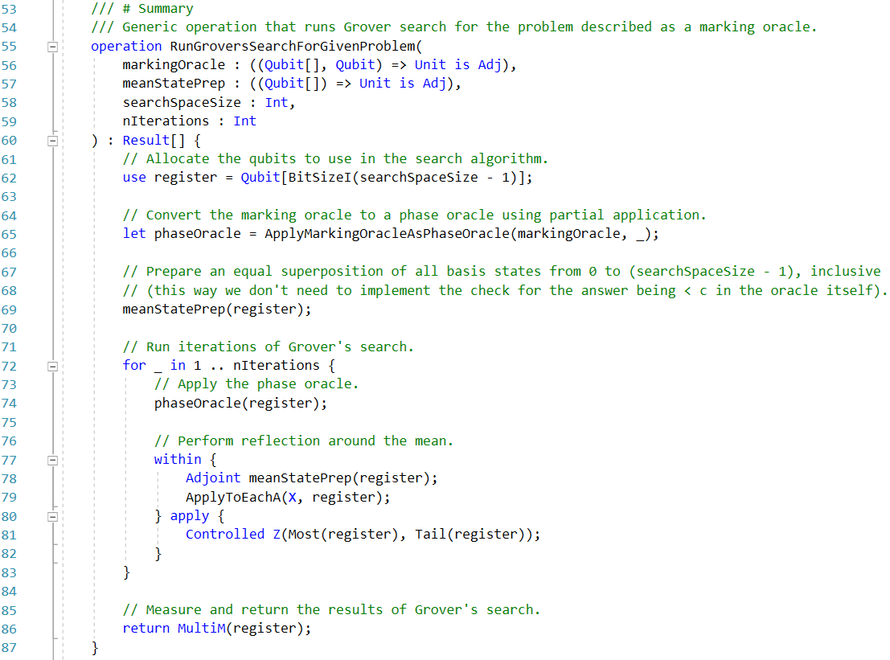
Why Q#?
High-level language designed for scalable quantum application development
Built-in quantum-specific data types, language constructs and compiler capabilities
Designed for running programs on quantum computers: build once, run locally or on a variety of hardware targets in Azure Quantum
Focused on high-level algorithms and ease of application development
Active language development: more convenient syntax for qubit allocation, type inference improvements, etc.

Slide 5
Basic concepts of quantum computing expressed in Q#

Slide 6
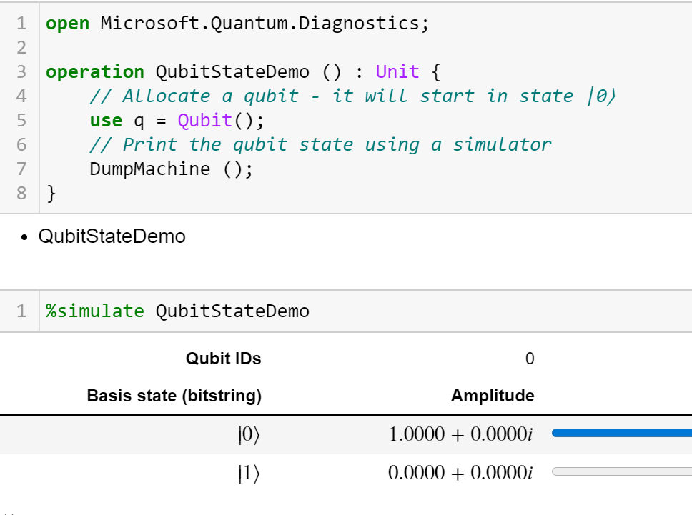
Qubits in Q#
Opaque data type similar to software objects: qubits have internal (hidden) state that can be accessed only via “getters” (measurements)
Mathematical notation of qubits describes qubit states (using vectors or ket notations)
Q# treats qubits as objects to perform operations on and does not expose the state of the system to the program; there is no representation of “quantum state” in Q#
This abstraction matches the principles of physical behavior of quantum systems
When running Q# code on a simulator, you get extra debugging capabilities, including DumpMachine function that allows you to peek at the quantum state

Slide 7
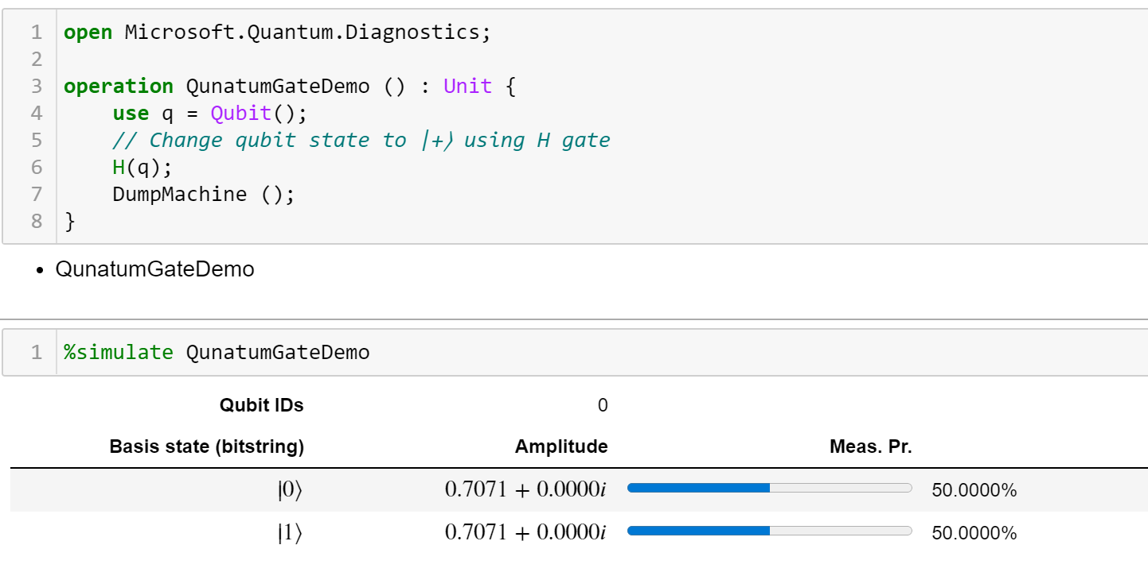
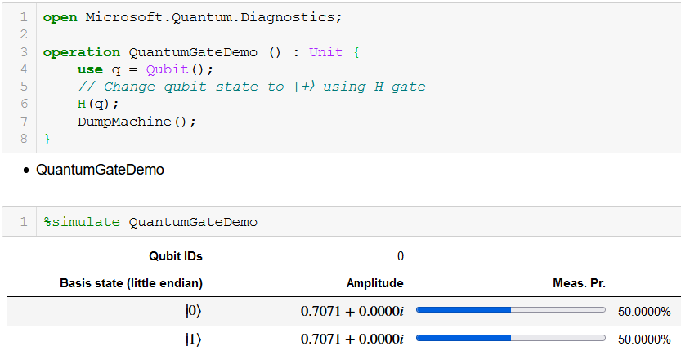
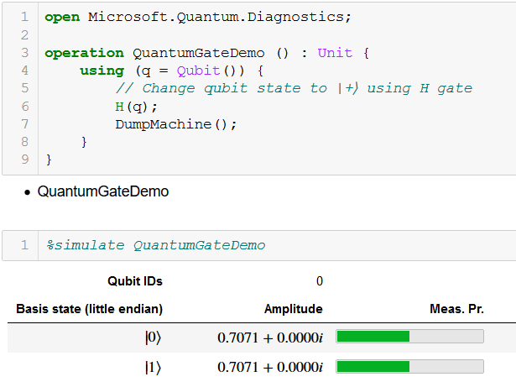
Quantum gates in Q#
Operations on qubits, with a side effect of changing the internal state of the system
Mathematical notation of quantum gates describes a transformation of qubit states (using matrices, ket-bra notation or “before” and “after” states)
Q# code treats gates as operations performed on qubits (possibly parameterized), with a side effect of changing the internal state of the system
This abstraction matches the principles of physical behavior of quantum systems
To aid debugging, DumpOperation operation allows to get matrix representation of a quantum operation

Slide 8
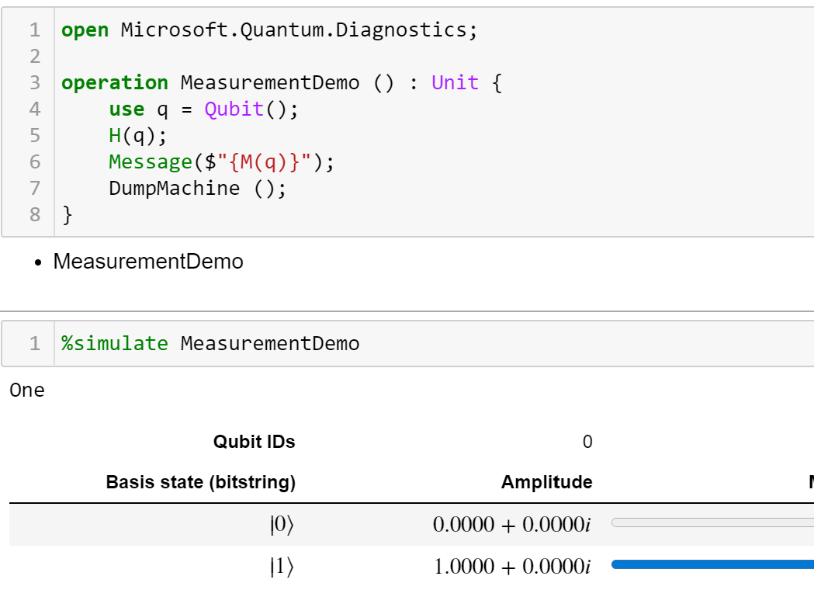
Measurements in Q#
Operations on qubits, with a side effect of changing the internal state of the system
Mathematical notation of measurements describes the measurement basis (i.e., the possible outcomes) and the outcome probabilities
Q# code treats measurements as operations performed on qubits (possibly parameterized), with a side effect of changing the system state
Return value is Result data type; has to be assigned to a variable, returned or printed

Slide 9
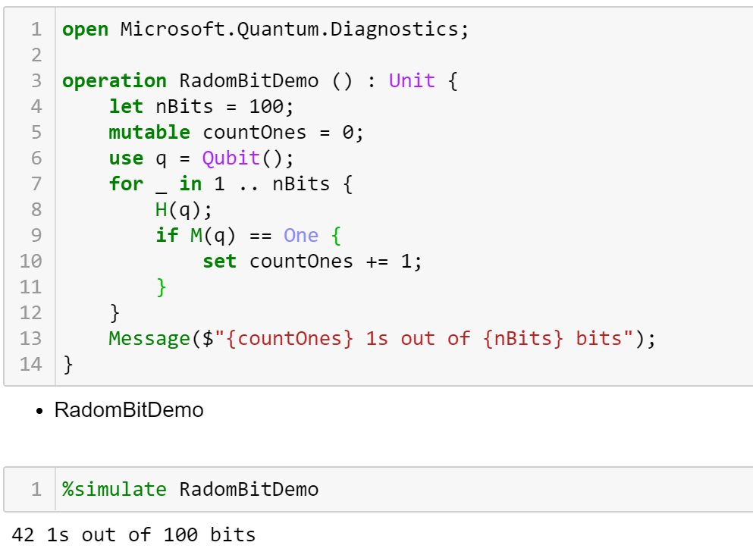
Example: random number generation
A peek at Q# variables and control flow
Q# distinguishes mutable and immutable variables
Control flow constructs are similar to classical languages, with if-then-else statements and for loops

